Slide 1
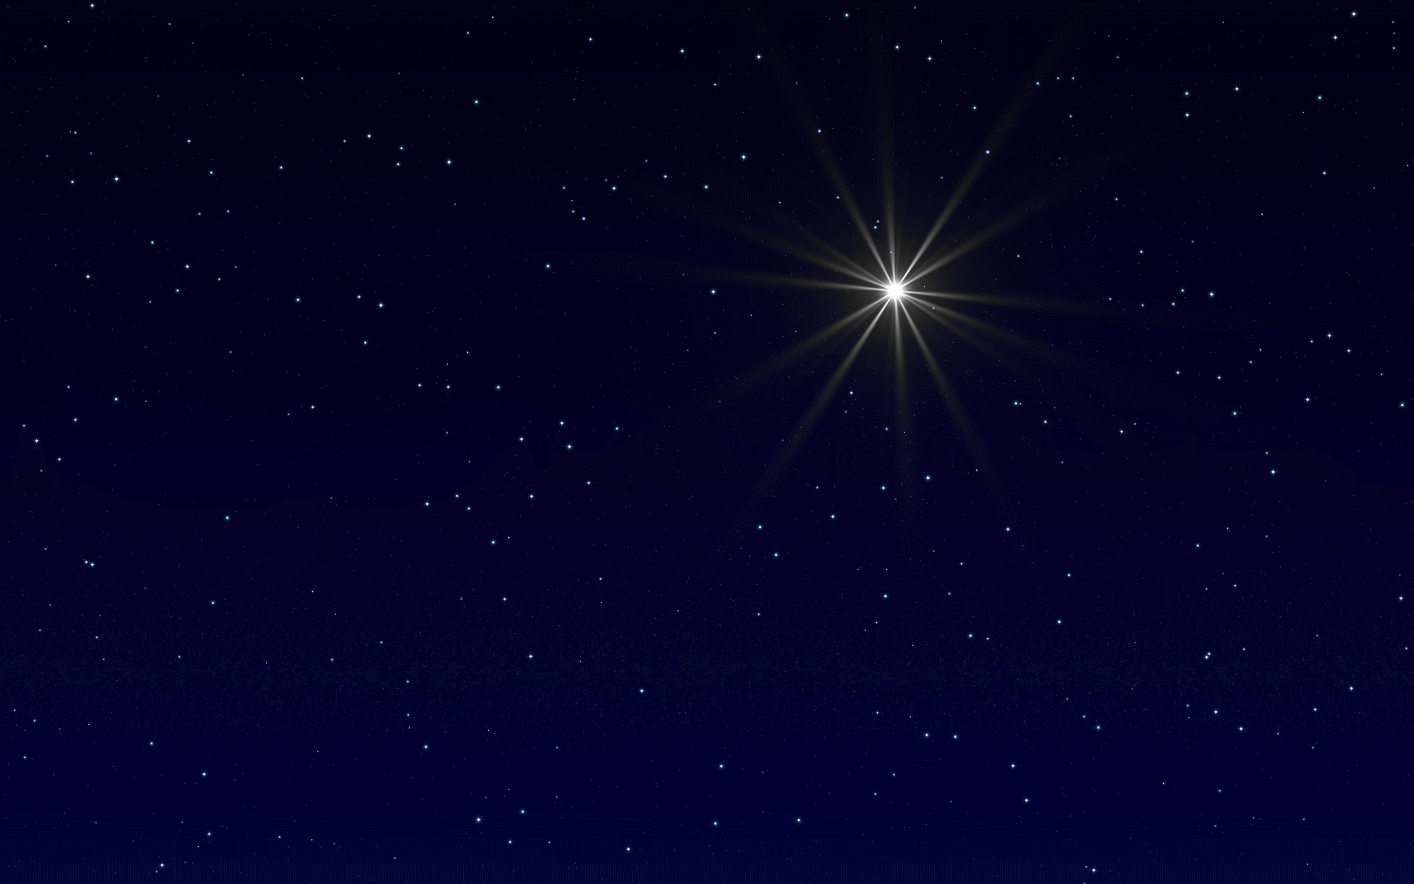
December 20, 2020
The Incarnation of Christ
John 1:1-14
And the Word became flesh, and dwelt among us, and we saw His glory,
glory as of the only begotten from the Father, full of grace and truth.

Slide 2
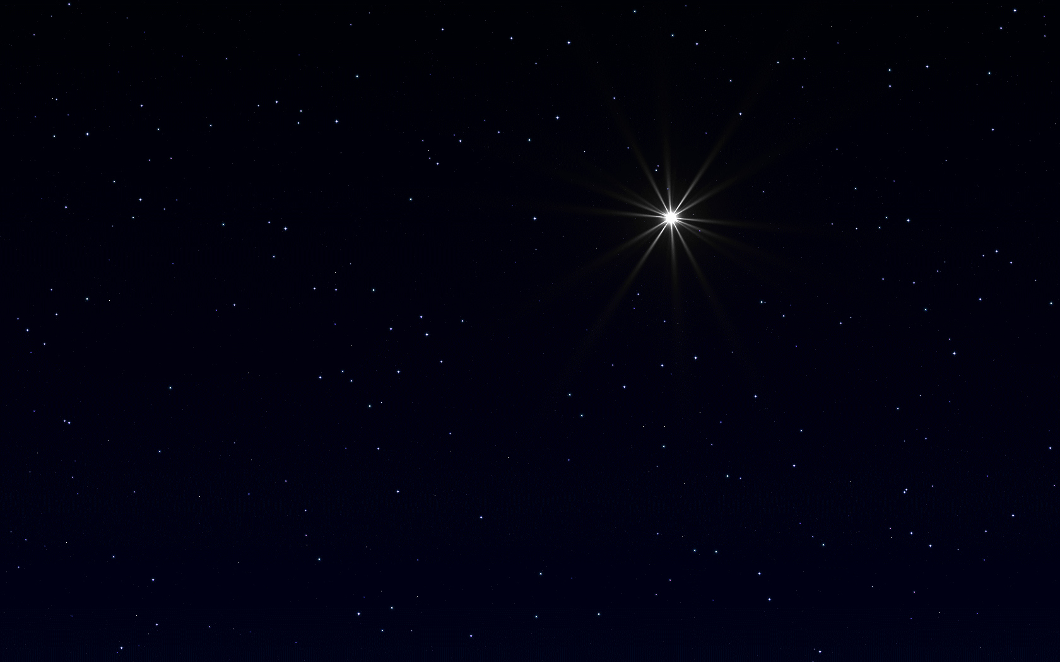
John 1:1-9
1 In the beginning was the Word, and the Word was with God, and the Word was God. 2 He was in the beginning with God. 3 All things came into being through Him, and apart from Him nothing came into being that has come into being. 4 In Him was life, and the life was the Light of men. 5 The Light shines in the darkness, and the darkness did not comprehend it. 6 There came a man sent from God, whose name was John. 7 He came as a witness, to testify about the Light, so that all might believe through him. 8 He was not the Light, but he came to testify about the Light. 9 There was the true Light which, coming into the world, enlightens every man.

Slide 3
John 1:10-14
10 He was in the world, and the world was made through Him, and the world did not know Him. 11 He came to His own, and those who were His own did not receive Him. 12 But as many as received Him, to them He gave the right to become children of God, even to those who believe in His name, 13 who were born, not of blood nor of the will of the flesh nor of the will of man, but of God. 14 And the Word became flesh, and dwelt among us, and we saw His glory, glory as of the only begotten from the Father, full of grace and truth.

Slide 4
The worth of the Word ^{(1:1-5)}
In the beginning was the Word…

Slide 5
The Word
“6 By the word of the Lord the heavens were made, And by the breath of His mouth all their host… 9 For He spoke, and it was done; He commanded, and it stood fast” (Psalm 33:6, 9).
“By faith we understand that the worlds were prepared by the word of God, so that what is seen was not made out of things which are visible” (Hebrews 11:3).
“1 God, after He spoke long ago to the fathers in the prophets in many portions and in many ways, 2 in these last days has spoken to us in His Son, whom He appointed heir of all things, through whom also He made the world” (Hebrews 1:1-2).

Slide 6
The worth of the Word ^{(1:1-5)}
In the beginning was the Word…
The Word is the Eternal God (1-2)
The Word was and is always existing.
The Word was and is always distinct from but in perfect fellowship with God.
The Word was and is always existing as God in character and essence.

Slide 7
The worth of the Word ^{(1:1-5)}
In the beginning was the Word…
The Word is the Eternal God (1-2)
The Word is the Creator (3)
The Word is Life (4)
The Word is Light (5)

Slide 8
The witness to the Word ^{(1:6-13)}
The witness of John the Baptist (6-8)
The witness of the Light (9-13)
The Light revealed (9)
The Light rejected (10-11)
The light received (12-13)

Slide 9
The wonder of the Word ^{(1:14)}
And the Word became flesh, and dwelt among us, and we saw His glory, glory as of the only begotten from the Father, full of grace and truth.
The Word became flesh. The Word, who is eternal God, Creator, life, and light took upon Himself the vestiges of creaturehood.

Slide 10
1 John 1:1
What was from the beginning, what we have heard, what we have seen with our eyes, what we have looked at and touched with our hands, concerning the Word of Life —

Slide 11
Hebrews 11:6
And without faith it is impossible to please Him, for he who comes to God must believe that He is and that He is a rewarder of those who seek Him.

Slide 12
Hebrews 12:1-3
1 Therefore, since we have so great a cloud of witnesses surrounding us, let us also lay aside every encumbrance and the sin which so easily entangles us, and let us run with endurance the race that is set before us, 2 fixing our eyes on Jesus, the author and perfecter of faith, who for the joy set before Him endured the cross, despising the shame, and has sat down at the right hand of the throne of God. 3 For consider Him who has endured such hostility by sinners against Himself, so that you will not grow weary and lose heart.

Slide 13
December 20, 2020
The Incarnation of Christ
John 1:1-14
And the Word became flesh, and dwelt among us, and we saw His glory,
glory as of the only begotten from the Father, full of grace and truth.

